Slide 1
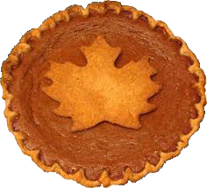
Thanksgiving Jeopardy!

Slide 2
Let’s Review
What is Thanksgiving?
Thanksgiving is a holiday for remembering what is good in our lives
Families get together and have fun.
Everyone eats a lot!

Slide 3
Let’s Review cont.
What family members might come over for Thanksgiving?
What foods might we eat?

Slide 4
Time to Play!
Get into your groups
Think of a name for your team

Slide 5
Thanksgiving Jeopardy!
Thanksgiving | Family | Food
100 | 100 | 100
200 | 200 | 200
300 | 300 | 300
400 | 400 | 400
500 | 500 | 500

Slide 6
The two words that make Thanksgiving

Slide 7
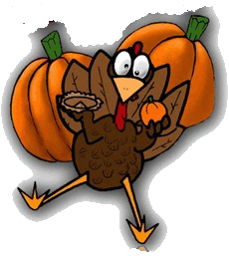
“Thanks” and “Giving”

Slide 8
Three things people do on Thanksgiving

Slide 9
Give thanks
See family
Eat!

Slide 10
The first people to celebrate Thanksgiving

Slide 11
The Pilgrims and the Native Americans

Slide 12
When is Thanksgiving this year?

Slide 13
The 22nd of November

Slide 15
When is Thanksgiving each year?

Slide 16
The 4th Thursday of November

Slide 17
Two words for parents

Slide 18
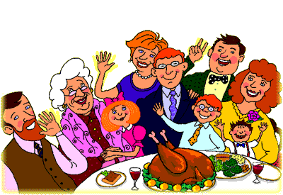
Mom, Dad, Mother, Father
Stepmother, Stepfather

Slide 19
The children of your parents are your ______ and _______

Slide 20
Brother and sisters
Bonus: siblings!

Slide 21
The parents of your parents are your ___________

Slide 22
Grandparents

Slide 23
Aunts and uncles are _______________

Slide 24
The sisters and brothers of your parents

Slide 25
The children of your aunts and uncles

Slide 26
Your cousins

Slide 27
What Thanksgiving food is red and made into a sauce?

Slide 28
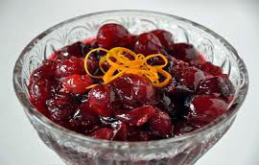
Cranberries!

Slide 29
_________ Potatoes

Slide 30
Mashed!

Slide 31
What is made with bread, onions, celery, and broth?

Slide 32
Stuffing!

Slide 33
What kind of pie do people eat on Thanksgiving?

Slide 34
Pumpkin
Apple

Slide 35
2 meals of the day

Slide 36
Breakfast
Brunch
Lunch
Dinner

Slide 37
Final Jeopardy!
Everyone has to answer!
Think of something you are thankful for.
Write a complete sentence telling what you are thankful for and why.
More details = more points!

Slide 38
Credits
Images
http://stacys101list.blogspot.com/2011/11/thursday-randomness.html
http://www.bens-maple-syrup.com/recipes/maple-dessert-recipes/ pie
http://ww2.valdosta.edu/~tihall/topic.html family
http://mycarolinakitchen.blogspot.com/2010/11/baked-ham-barefoot-contessa-style.html cranberry
Original clip art created from image taken from
http://www.infanttoddler.com/thanksgiving-nov-24-25/
Sounds
“Thanksgiving,” “Family,” and “Food” are original
“Jeopardy Theme Song” is taken from http://www.youtube.com/watch?v=0Wi8Fv0AJA4

